Slide 1


Lecture 30
Produced by Dr. Worldwide
Welcome to the 305
~
~

Slide 2




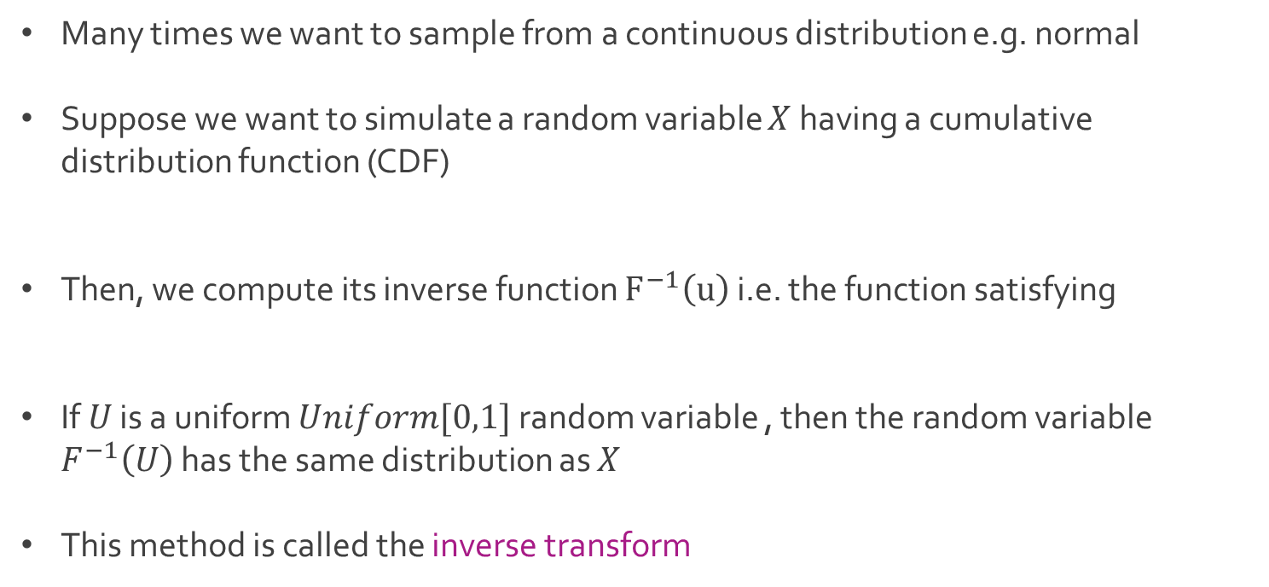
Simulation for Continuous
Many times we want to sample from a continuous distribution e.g. normal
Suppose we want to simulate a random variable $X$ having a cumulative distribution function (CDF)
Then, we compute its inverse function $F^{−1}\left(u\right)$ i.e. the function satisfying
If $U$ is a uniform $Uniform[0,1]$ random variable , then the random variable $F^{−1}\left(U\right)$ has the same distribution as $X$
This method is called the inverse transform

Slide 3

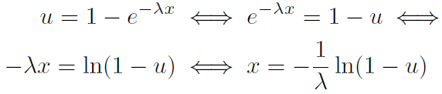
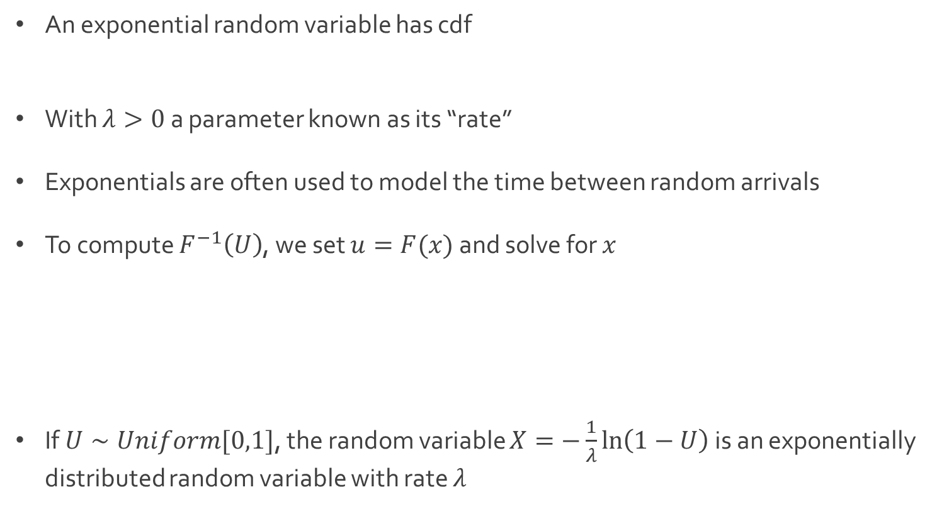
Exponential Simulation
An exponential random variable has cdf
With $λ>0$ a parameter known as its “rate”
Exponentials are often used to model the time between random arrivals
To compute $F^{−1}\left(U\right)$, we set $u=F(x)$ and solve for $x$
If $U∼Uniform[0,1]$, the random variable $X=−\frac{1}{λ}\ln\left(1−U\right)$ is an exponentially distributed random variable with rate $λ$

Slide 4

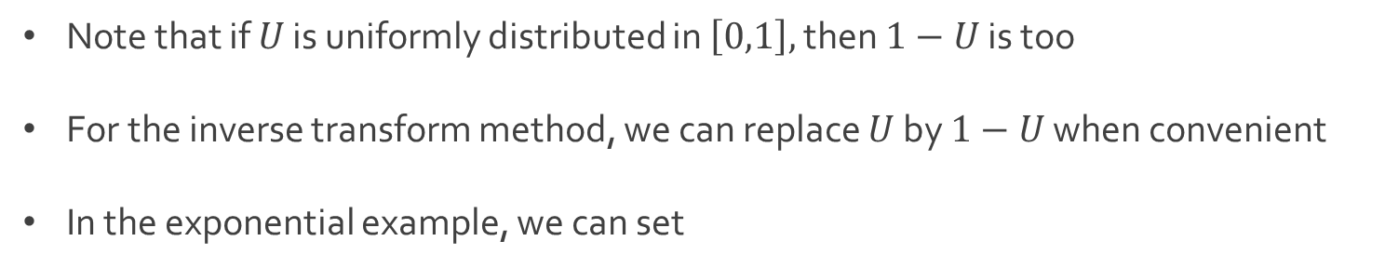
Exponential Simulation
Note that if $U$ is uniformly distributed in $\left[0,1\right],$ then $1−U$ is too
For the inverse transform method, we can replace $U$ by $1−U$ when convenient
In the exponential example, we can set

Slide 5
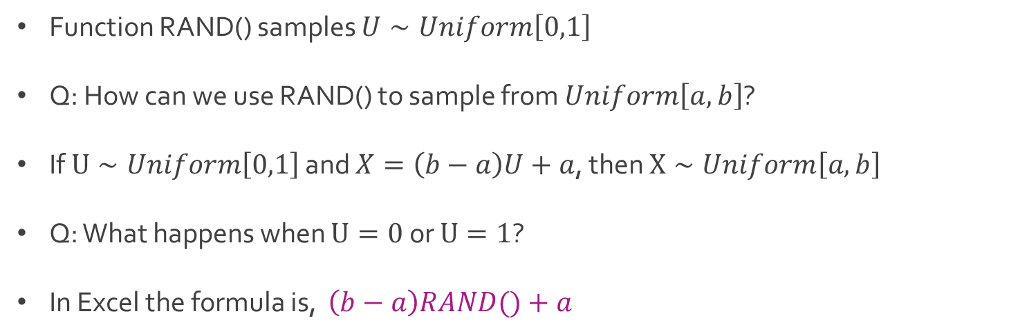
Uniform Simulation
Function RAND() samples $U∼Uniform\left[0,1\right]$
Q: How can we use RAND() to sample from $Uniform\left[a,b\right]$?
If $U∼Uniform\left[0,1\right]$ and $X=\left(b−a\right)U+a$, then $X∼Uniform\left[a,b\right]$
Q: What happens when $U=0$ or $U=1$?
In Excel the formula is, $\left(b−a\right)RAND()+a$

Slide 6

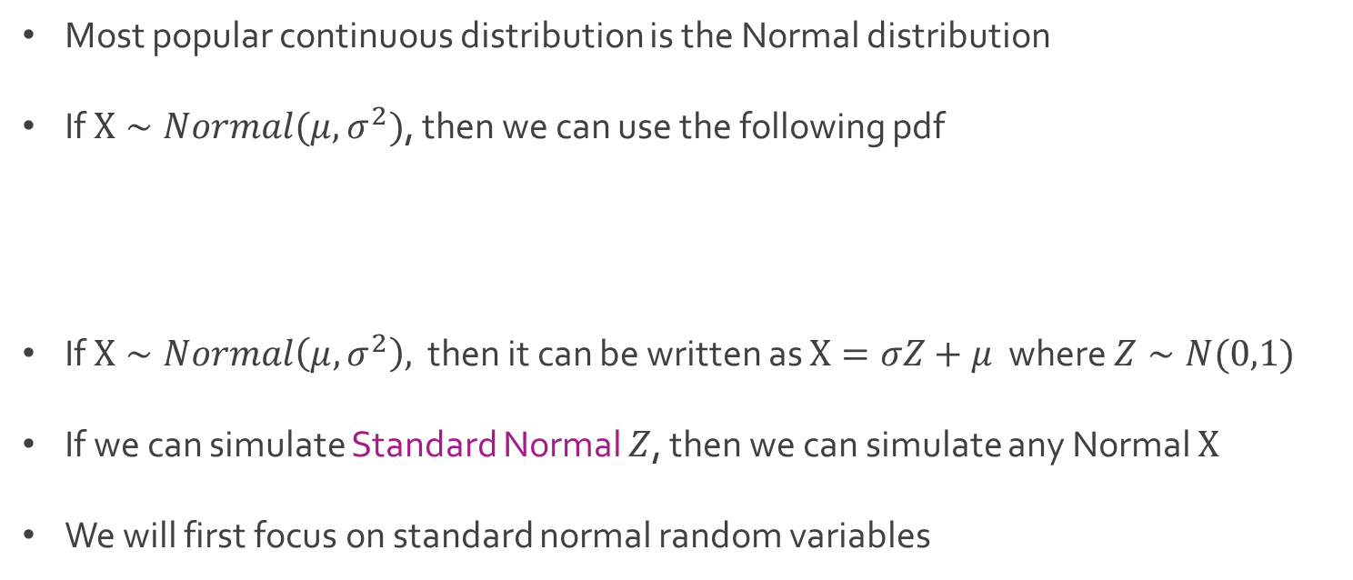
Normal Simulation
Most popular continuous distribution is the Normal distribution
If $X∼Normal(μ, σ^{2})$, then we can use the following pdf
If $X∼Normal\left(μ, σ^{2}\right),$ then it can be written as $X=σZ+μ$ where $Z∼N(0,1)$
If we can simulate Standard Normal $Z$, then we can simulate any Normal $X$
We will first focus on standard normal random variables

Slide 7

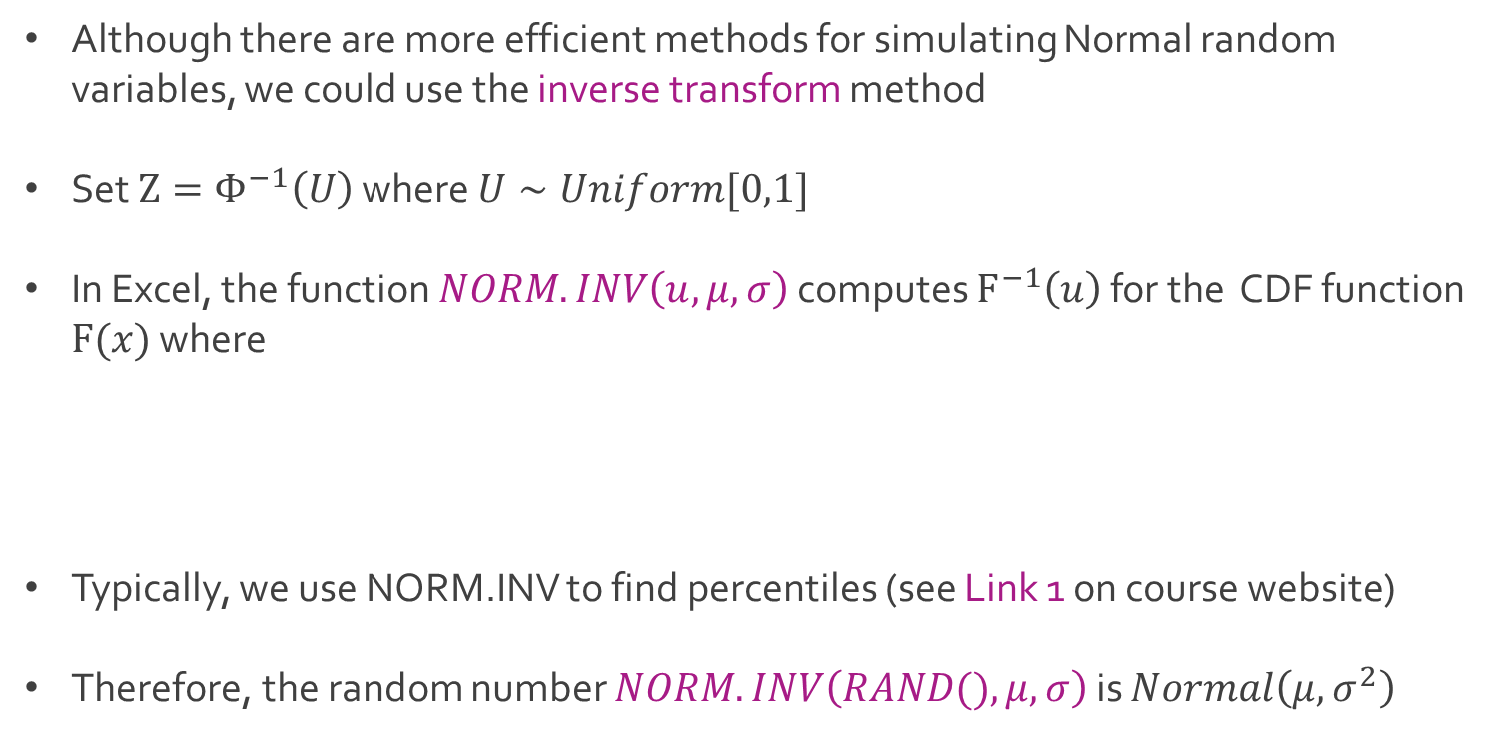
Normal Simulation
Although there are more efficient methods for simulating Normal random variables, we could use the inverse transform method
Set $Z=Φ^{−1}\left(U\right)$ where $U∼Uniform[0,1]$
In Excel, the function $NORM.INV\left(u, μ, σ\right)$ computes $F^{−1}\left(u\right)$ for the CDF function $F(x)$ where
Typically, we use NORM.INV to find percentiles (see Link 1 on course website)
Therefore, the random number $NORM.INV\left(RAND(), μ, σ\right)$ is $Normal\left(μ,σ^{2}\right)$

Slide 8
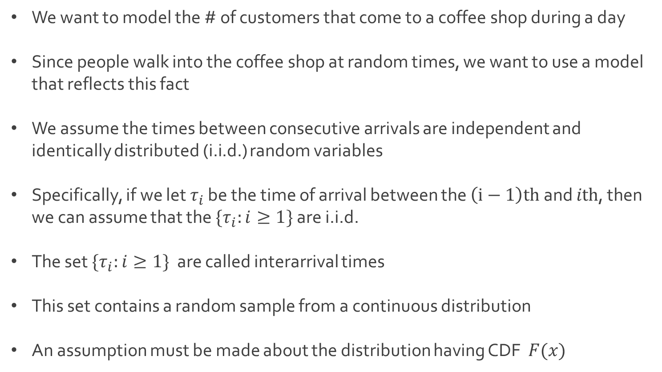
Ex: Arrival Process
We want to model the # of customers that come to a coffee shop during a day
Since people walk into the coffee shop at random times, we want to use a model that reflects this fact
We assume the times between consecutive arrivals are independent and identically distributed (i.i.d.) random variables
Specifically, if we let $τ_{i}$ be the time of arrival between the $\left(i−1\right)th$ and $ith$, then we can assume that the $\{τ_{i}:i≥1\}$ are i.i.d.
The set $\{τ_{i}:i≥1\}$ are called interarrival times
This set contains a random sample from a continuous distribution
An assumption must be made about the distribution having CDF $F(x)$

Slide 9
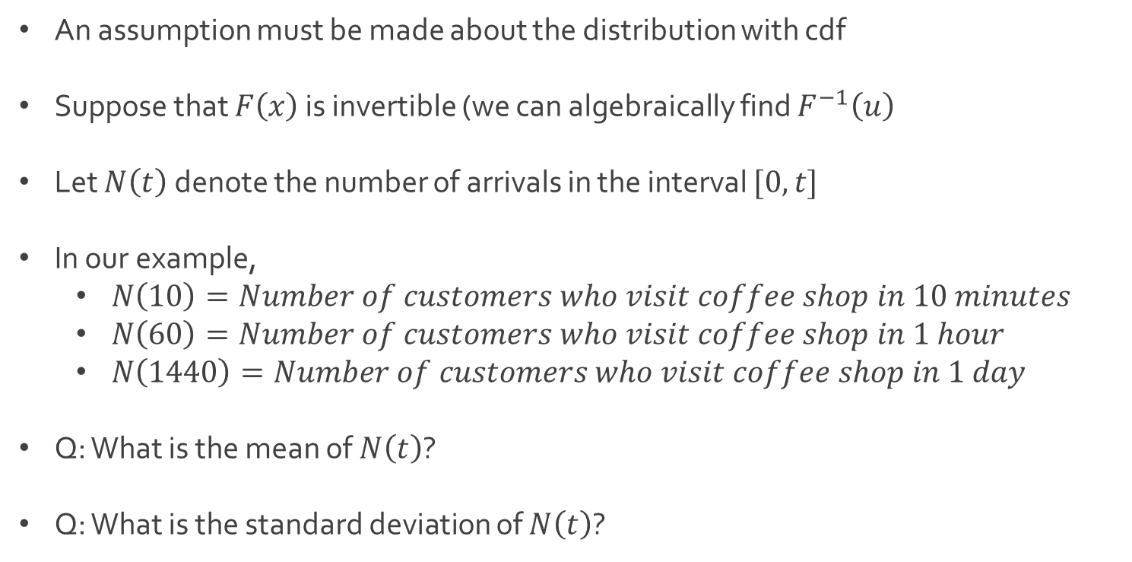
Ex: Arrival Process
An assumption must be made about the distribution with cdf
Suppose that $F\left(x\right)$ is invertible (we can algebraically find $F^{−1}\left(u\right)$
Let $N\left(t\right)$ denote the number of arrivals in the interval $[0,t]$
In our example,
$N\left(10\right)=Number of customers who visit coffee shop in 10 minutes$
$N\left(60\right)=Number of customers who visit coffee shop in 1 hour$
$N\left(1440\right)=Number of customers who visit coffee shop in 1 day$
Q: What is the mean of $N\left(t\right)$?
Q: What is the standard deviation of $N\left(t\right)$?

Slide 10
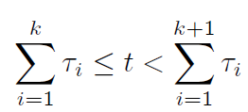
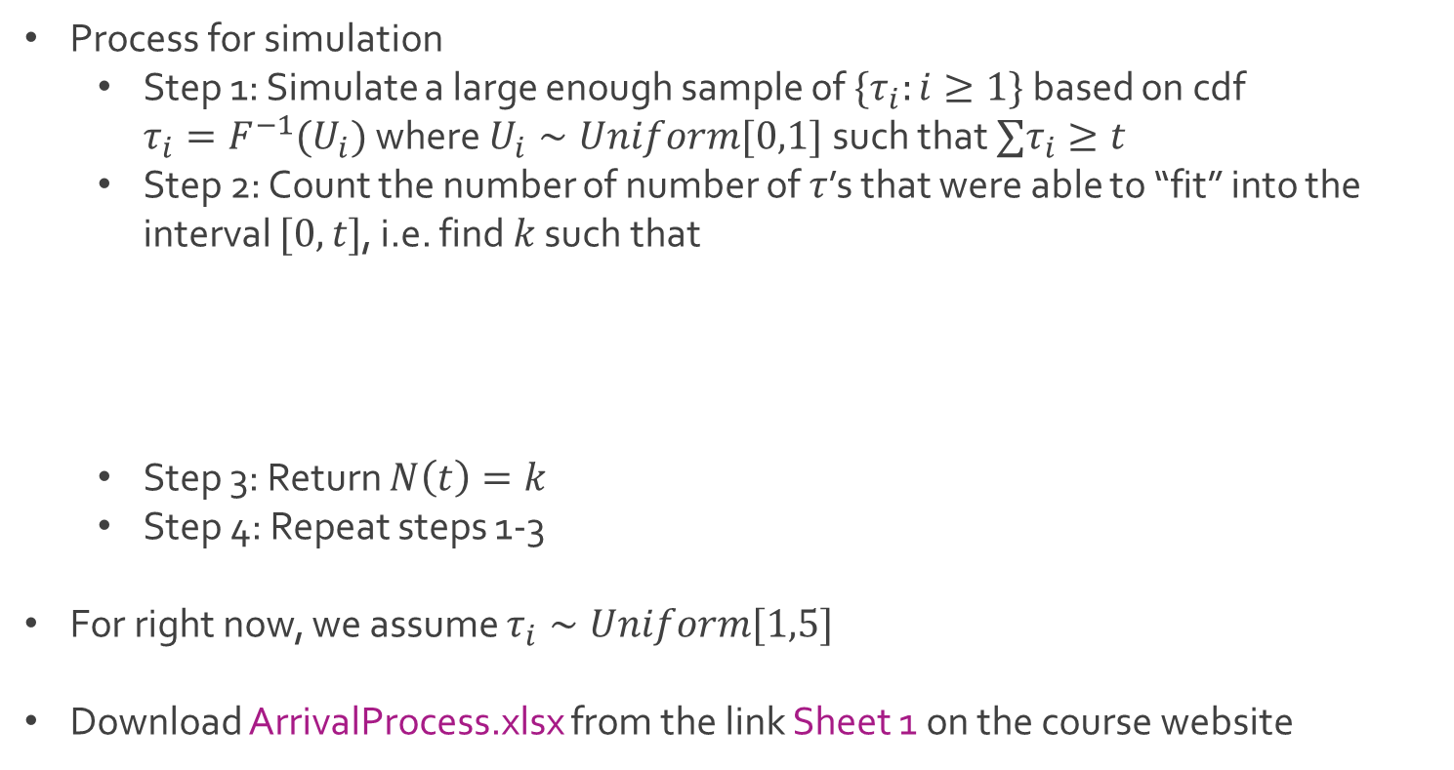
Ex: Arrival Process
Process for simulation
Step 1: Simulate a large enough sample of $\{τ_{i}:i≥1\}$ based on cdf ${τ_{i}=F}^{−1}(U_{i})$ where $U_{i}∼Uniform[0,1]$ such that $∑τ_{i}≥t$
Step 2: Count the number of number of $τ$’s that were able to “fit” into the interval $[0,t]$, i.e. find $k$ such that
Step 3: Return $N\left(t\right)=k$
Step 4: Repeat steps 1-3
For right now, we assume $τ_{i}∼Uniform[1,5]$
Download ArrivalProcess.xlsx from the link Sheet 1 on the course website

Slide 11
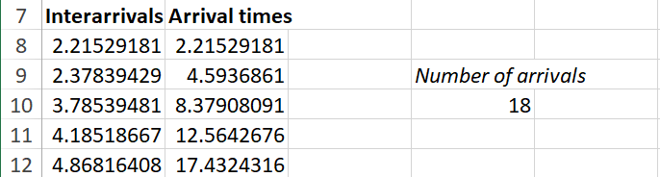
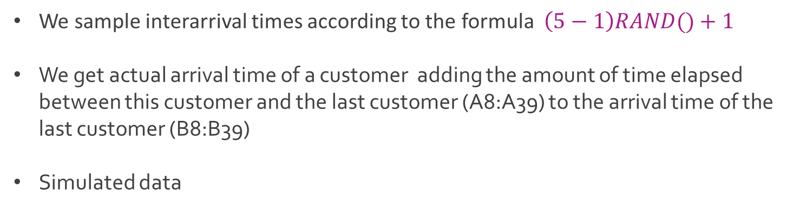
Ex: Arrival Process
We sample interarrival times according to the formula $\left(5−1\right)RAND()+1$
We get actual arrival time of a customer adding the amount of time elapsed between this customer and the last customer (A8:A39) to the arrival time of the last customer (B8:B39)
Simulated data

Slide 12
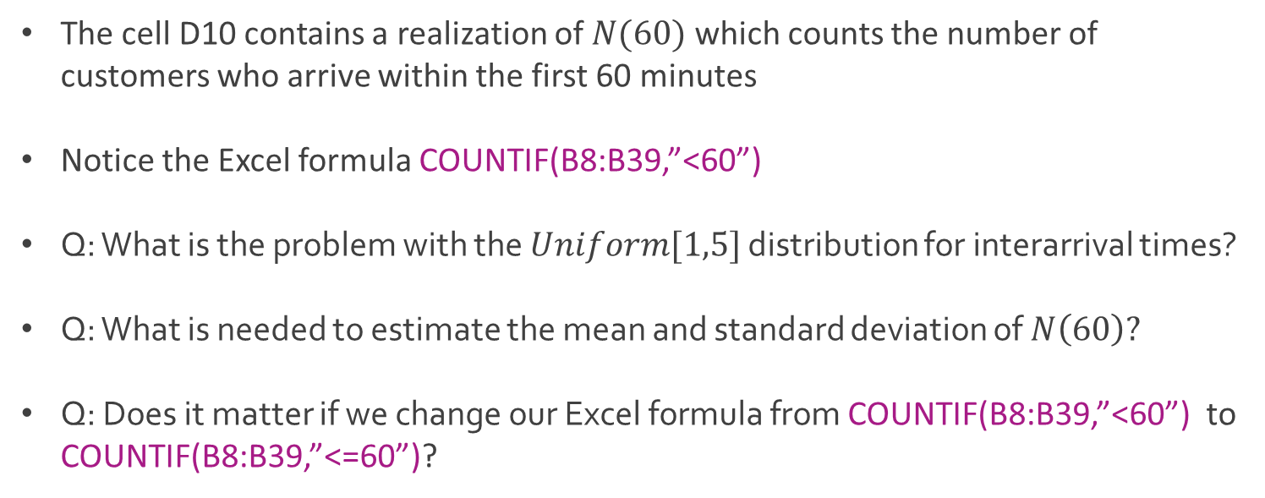
Ex: Arrival Process
The cell D10 contains a realization of $N(60)$ which counts the number of customers who arrive within the first 60 minutes
Notice the Excel formula COUNTIF(B8:B39,”<60”)
Q: What is the problem with the $Uniform[1,5]$ distribution for interarrival times?
Q: What is needed to estimate the mean and standard deviation of $N\left(60\right)?$
Q: Does it matter if we change our Excel formula from COUNTIF(B8:B39,”<60”) to COUNTIF(B8:B39,”<=60”)?

Slide 13




The End
Dale

